Slide 1
Data Structures and Algorithms

Slide 2
What are Data Structures and Algorithm?
Data: Data is a collection of values
Structure: It is the way of organizing.
Algorithms: A step by step procedure or formula for solving a problem.

Slide 3
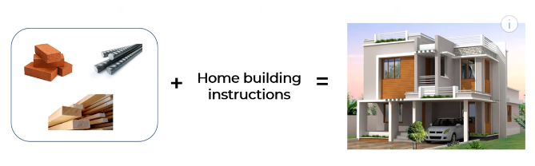

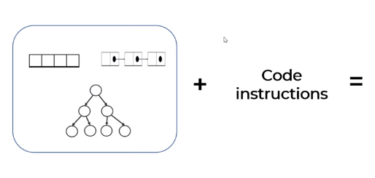

Slide 4
Data structures and Algorithm: There are essential components that help organize and store data efficiently in computer memory. They provide a way to manage and manipulate data effectively, enabling faster access.
Data structures and algorithms make it simple for people to find and deal with the information they need.

Slide 5
Why to learn?
P\ 1.Problem-Solving Skills:
Think logically and solve problems methodically
Choose the right approach to solve a problem efficiently
Write optimized and efficient code that performs well
2. Building Applications: Many real-world applications require efficient data processing. For example, search engines, social media platforms, and financial systems rely heavily on efficient data structures and algorithms.
3.Interview Preparation: Many technical job interviews focus heavily on DSA concepts. Companies like Google, Amazon, Facebook, and Microsoft often ask candidates to solve problems that require a good understanding of data structures and algorithms.
4.Performance: Efficient data structures and algorithms are essential for writing code that runs quickly and uses resources (memory, CPU) effectively. This is crucial for applications that need to scale or handle large volumes of data.

Slide 6
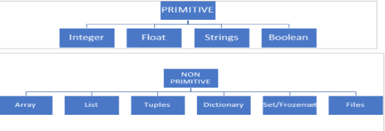
Types of Data Structures
Primitive : If any keyword (Pre-Define) in the form of data type is called primitive structure.
Non Primitive : Non premitive structure are those that are derived from primitive.

Slide 7
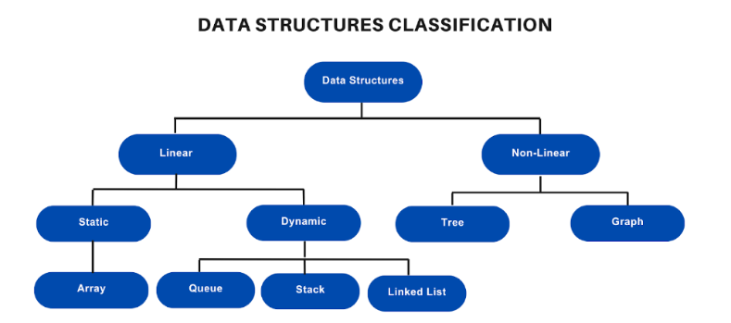

Slide 8
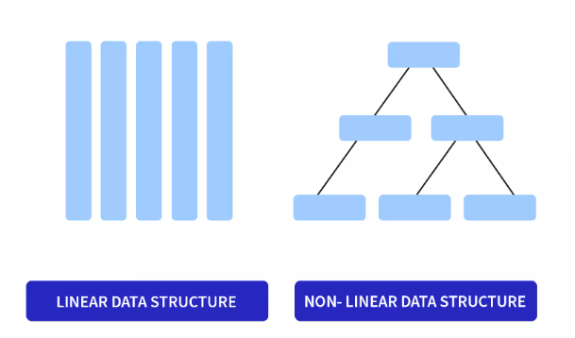
Linear and Nonlinear

Slide 9
Most common Data structures
Array
String
Linkedlist
dictionaries/hashmap
stack/queue
Trees
Graphs

Slide 10
Most common coding algorithms
1.Binary search
2. Linear Search
4. Merge sort
5. Quicksort
6.insertion sort
7.Selection sort
8.Heap sort

Slide 11
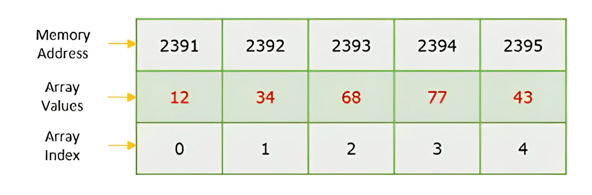
Array Data Structure
An array is a linear data structure. It is a collection of items of same data type(int, float, boolean, string)
It hold upto N items
.

Slide 12
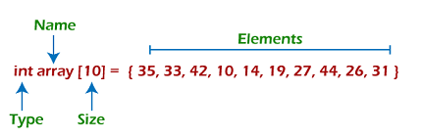
Why we use arrays?
To store large number of elements under a single variable name.

Slide 13
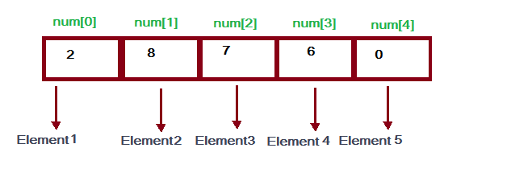
How to access elements in array?
Every element of an array can accessed through its index.
Index of array always starts with 0 and ends at N-1.

Slide 14
Array Capacity VS Array Length
Number of element an array can hold is called its capacity of array.
Arr[6] = [1,2,3,4,5,6]
arr= [1,2,3,4,5,6]
Number of elements currently in an array is called length of array.
Length of array = len(arr)

Slide 15
Types of Arrays
Arrays can be categorized into different types:
1.One dimensional array
2. Two dimensional array
3. Three dimensional array

Slide 16
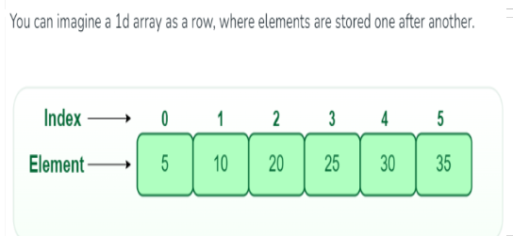
One Dimensional Array

Slide 17
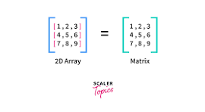
2. Two Dimensional Array

Slide 18
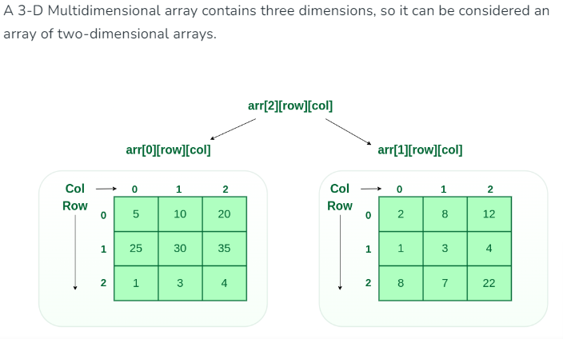
3. Three Dimensional Array

Slide 19
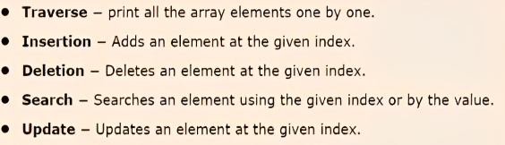
Basic operations in an Array

Slide 20
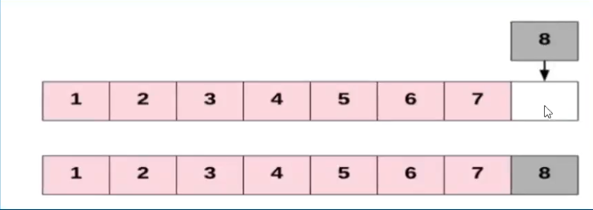
Array Insertion
Inserting a new element in an array
Inserting a new element at the end of the array.

Slide 21
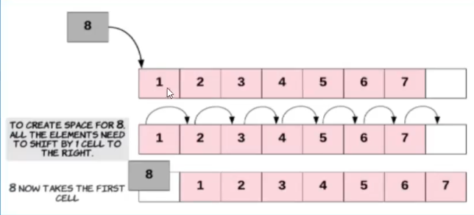
2. Inserting a new element at the beginning of the array.

Slide 22
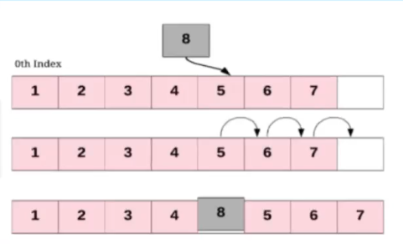
3. Inserting a new element at any given index of the array.

Slide 23
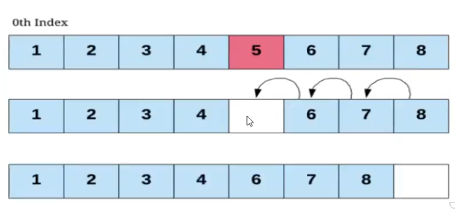
Array Deletion

Slide 24
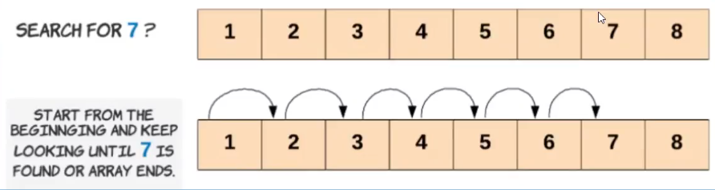
Array Search

Slide 25
Real time Applications of Array
Music and Videos: Have you ever noticed how your phone or computer can play music and videos smoothly? That's because they use arrays to store the individual sounds and images that make up the media.

